Slide 1
Bank System
Wan Yu Yang

Slide 2
Introduction
This is a bank system. It is used on a Automated Teller Machine.
After user logs in his/ her account, he/she can deposit, and withdraw from his/her account.
User can transfer to other user’s account.
I use SQLite as my database

Slide 3
Demo

Slide 4
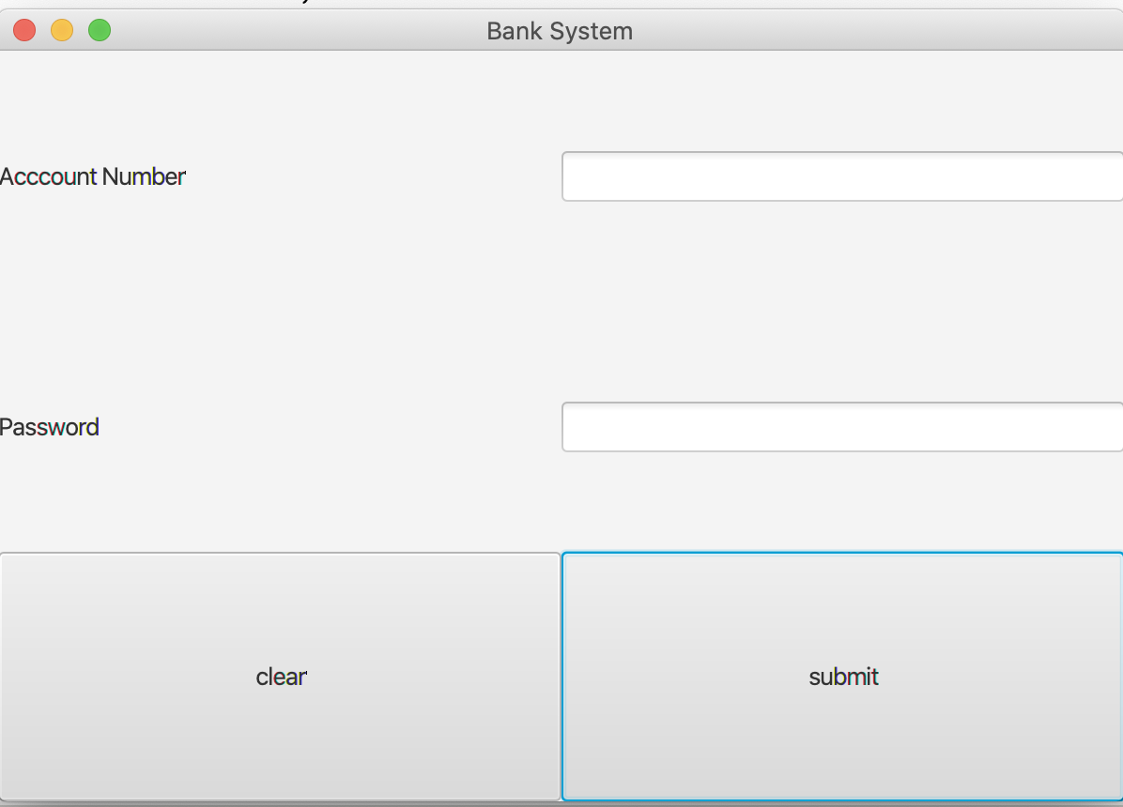
Demo---Log in
Log in page: User use account number and password to log in his/her account.

Slide 5
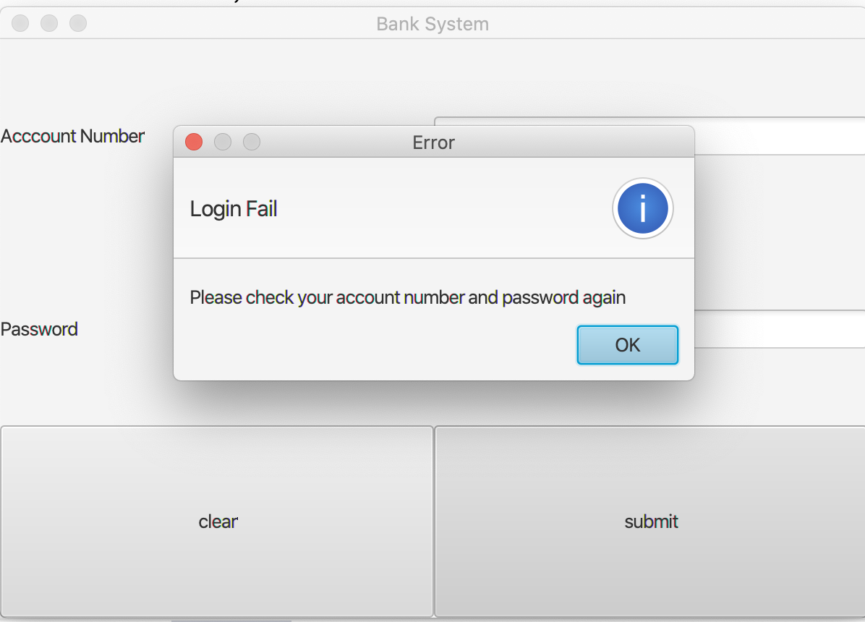
Demo-- Log in Fail
If user enters wrong account number or password, system will alert user.

Slide 6
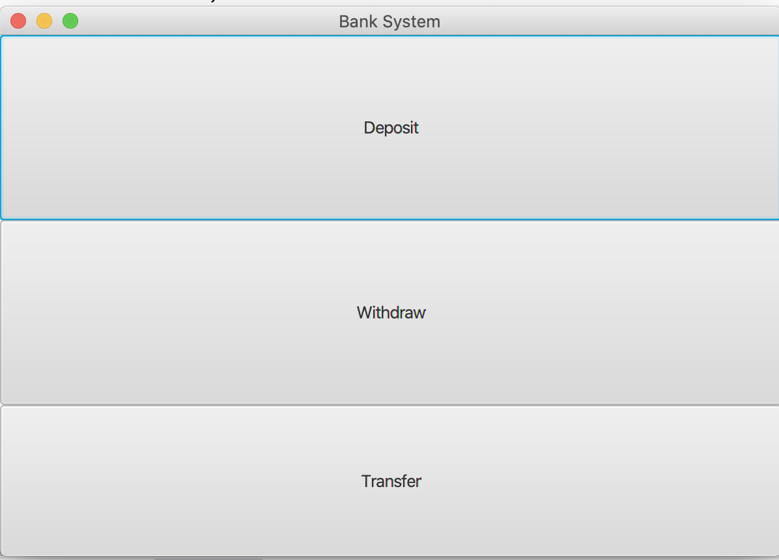
Demo—Success log in
If user enters the correct account number and password, the system enters select type page.
User can select one of them.

Slide 7
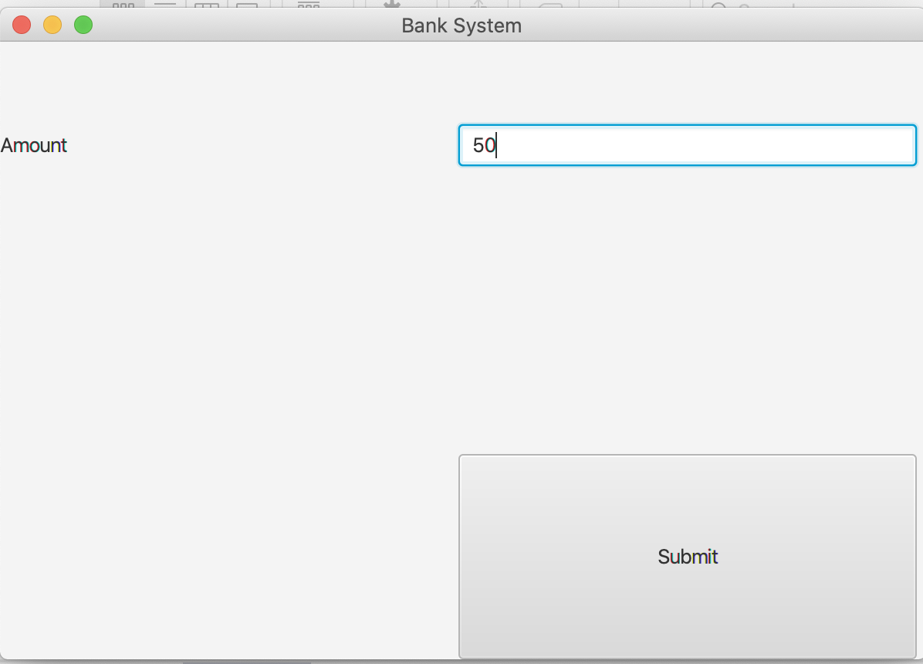
Demo—Deposit
If user selects deposit, the system will enter this page.
User can enter the deposit amount.

Slide 8
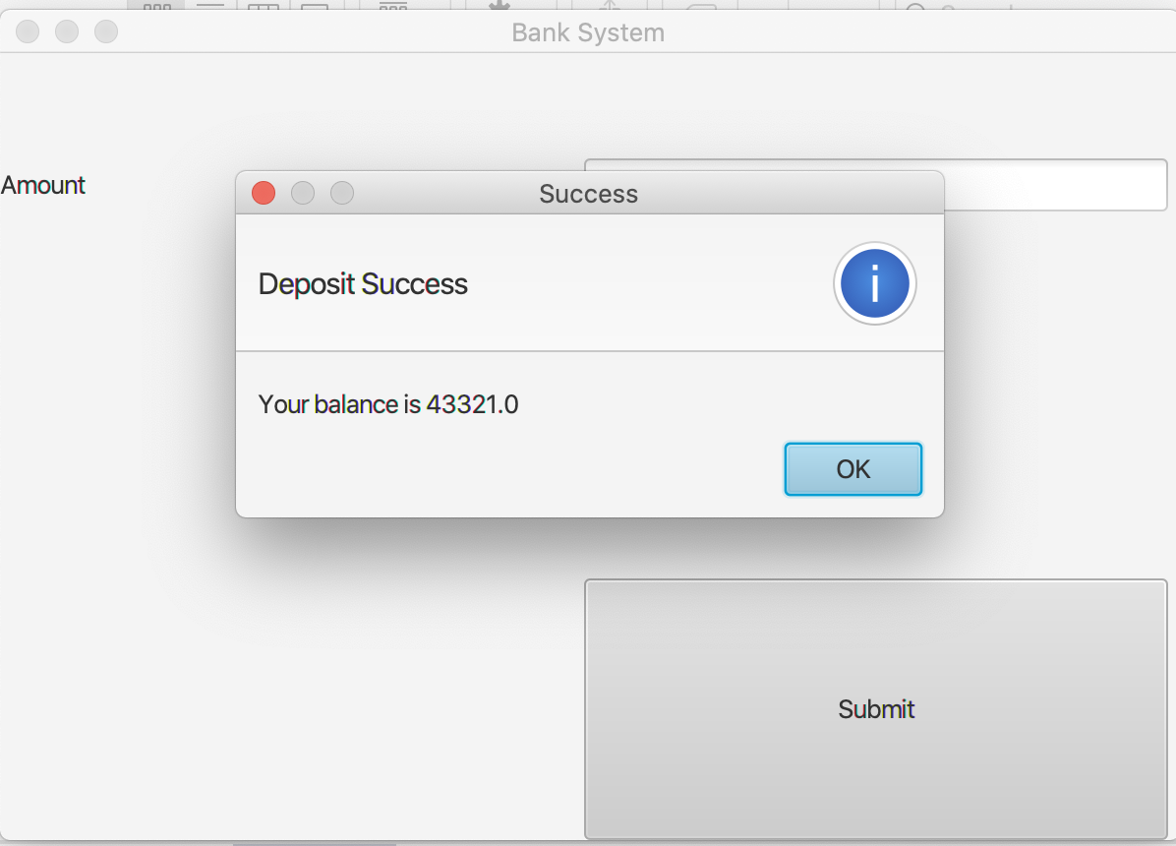
Demo– Deposit Success
After user clicks submit,
the system will alert the deposit success

Slide 9
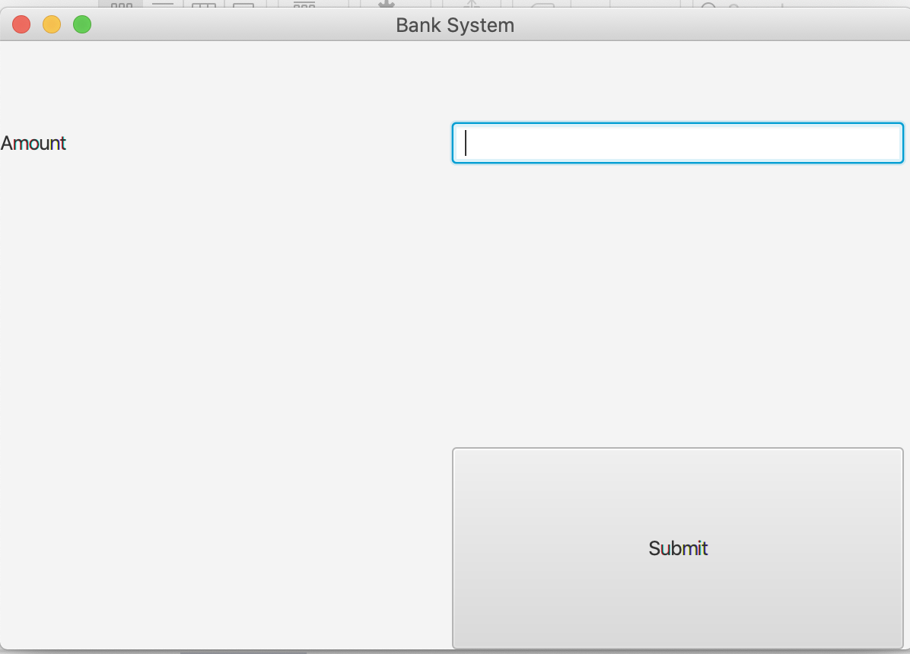
Demo--Withdraw
If user selects withdraw, the system will enter this page.
User can enter amount.

Slide 10

Demo—Withdraw Success
If withdraw success, the system will alert user

Slide 11
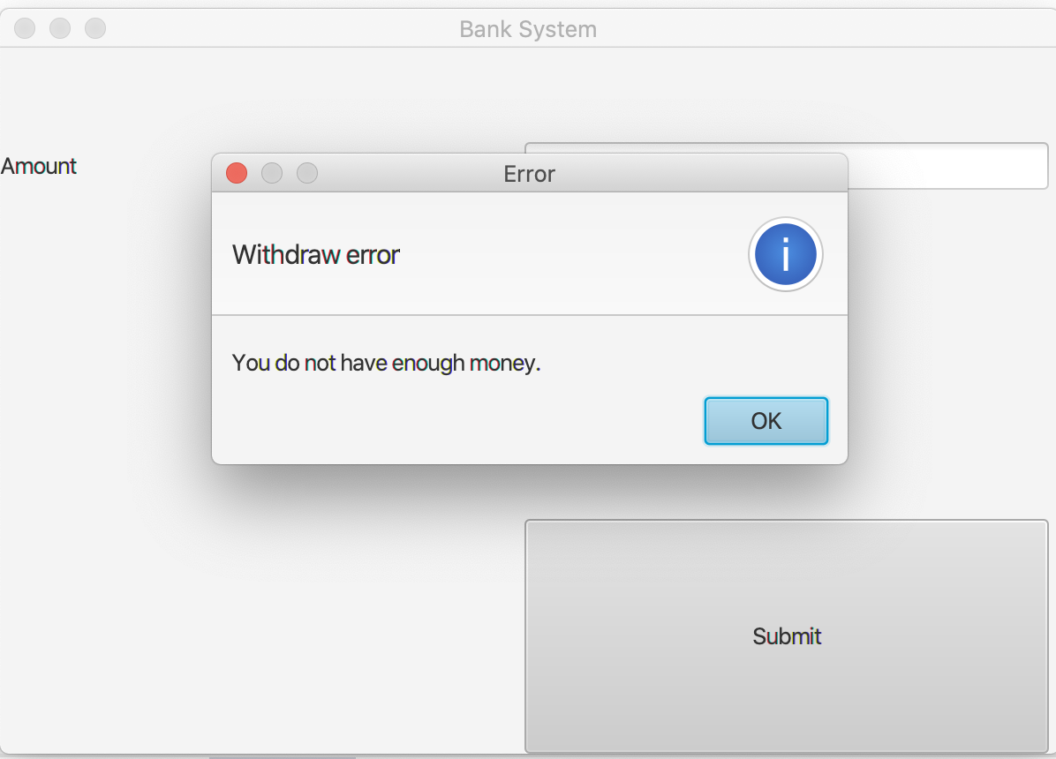
Demo—Withdraw Fail
If user inputs the amount bigger than account balance, the system will alert user.
It cause withdraw fail.

Slide 12
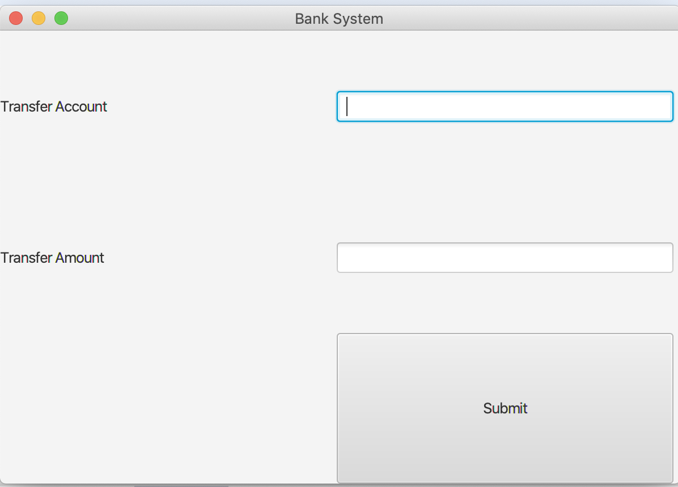
Demo-- Transfer
If user selects transfer, the system will enter this page.
The user can enter the target account and amount.

Slide 13
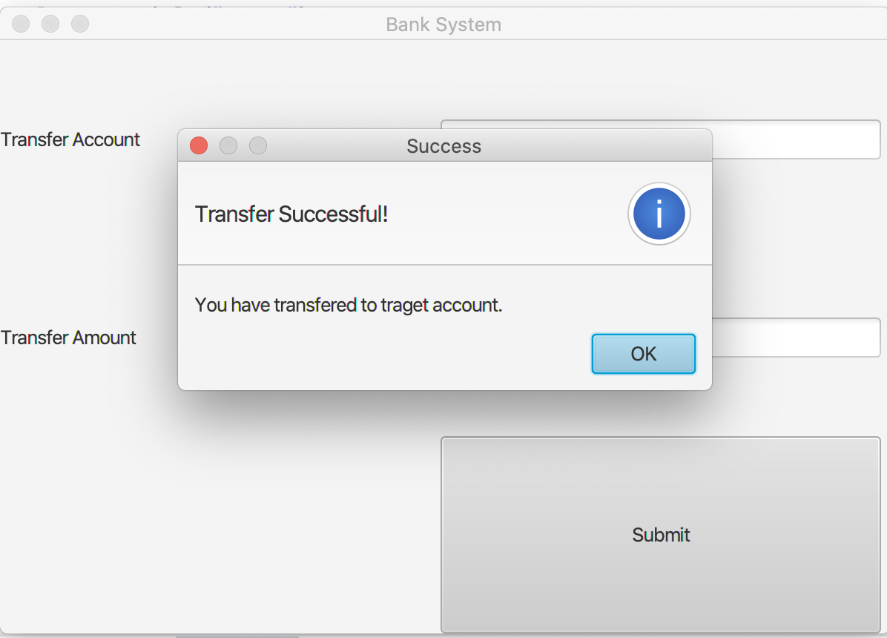
Demo—Transfer Success
If the transfer is valid, the system will alert the user

Slide 14
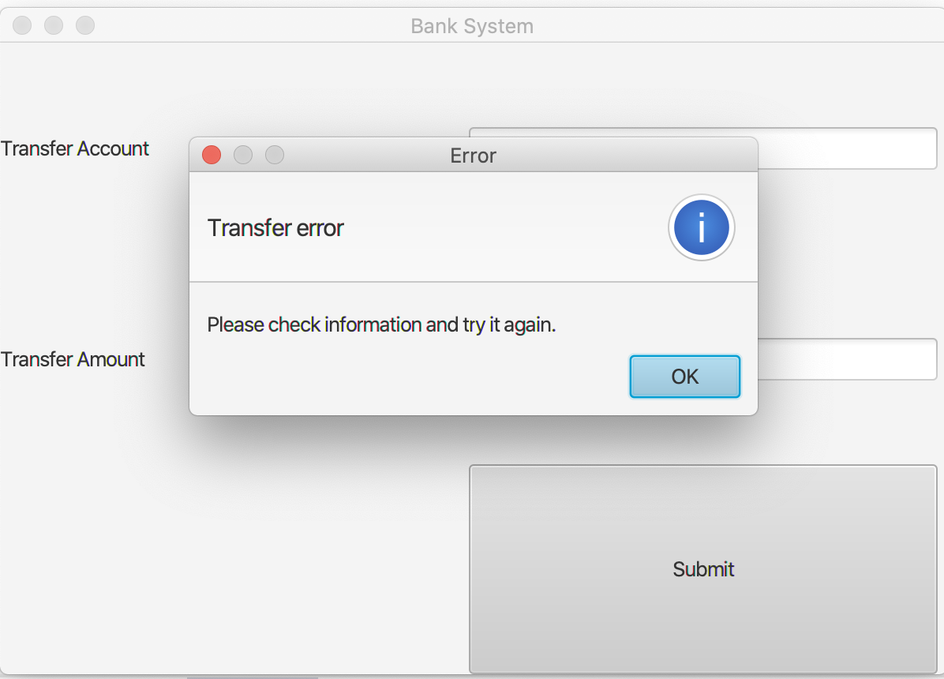
Demo—Transfer Fail
If transfer is not valid, the user will alert user.

Slide 15
Interact with database

Slide 16

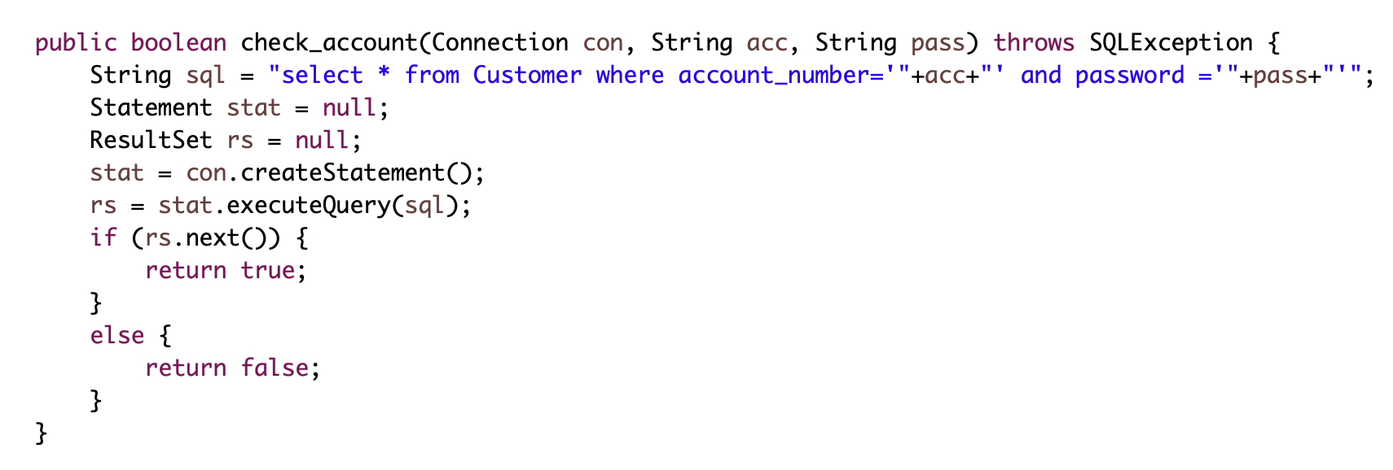
Check login
Determine whether account number and password are correct
If the account and password are existed, it will returntrue. Otherwise, it will return false

Slide 17

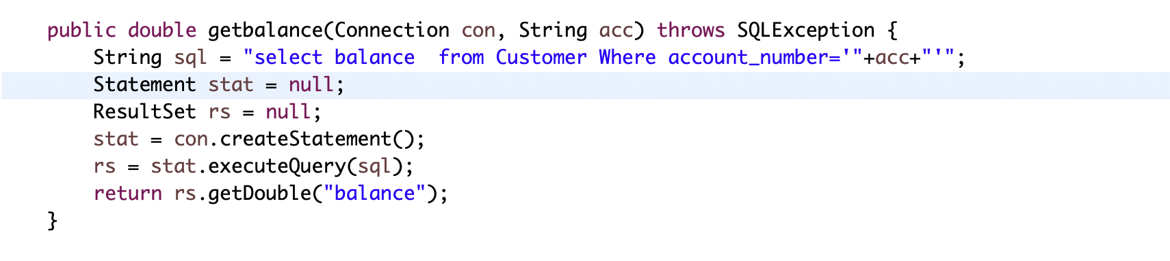
Read data from database
To get the balance
Use the account number to read the balance

Slide 18

Write data into database
Update the balance
Use the account to determine the account and update the balance

Slide 19
Thank for your attention Do you have any question?

